Slide 1
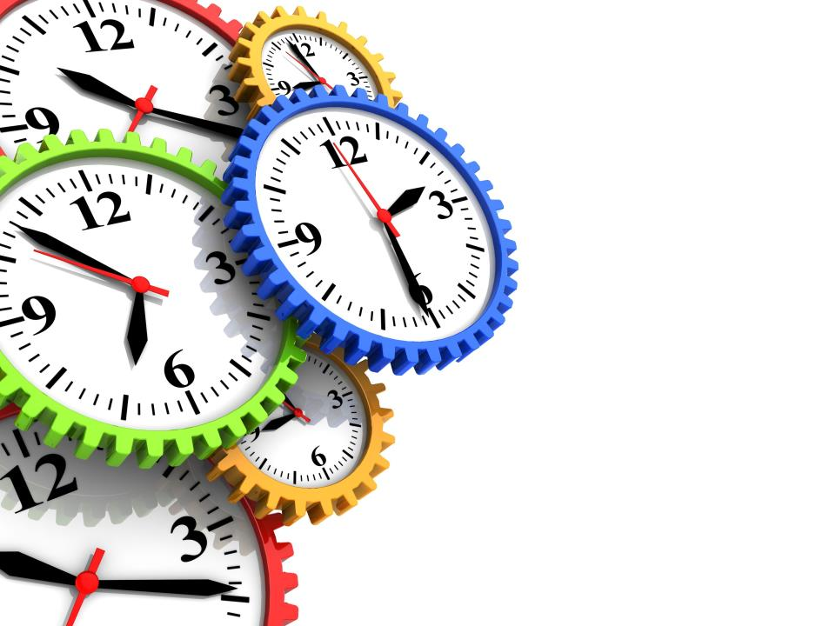
Time
Management

Slide 2
What is Time Management?
Time management is an art. It is arranging, organizing and budgeting time for the purpose of accomplishing something within a time.
Time management is having control over the amount of time spent on a particular activity.
Hence, time management helps an individual to be more organized and more productive.

Slide 3
Importance of Time Management
Time management is important as it helps to manage our time efficiently. It is beneficial to every individual as proper time management helps us to:
Plan efficiently
Be Efficient
Schedule efficiently
Be Organized
Prioritize tasks
Be Relaxed &
less stressed
Be Self-disciplined
Have time for
ourselves

Slide 4
Who can use Time Management ?
Business Leader
Politicians
Students
Teachers
Labourer's
Writers
Working Professional
Home Makers

Slide 5
Elements of Time Management
There are various elements that have to be considered and managed for effective Time Management. It is important that for us to manage our time well, we should learn be aware of and use the elements of Time Management diligently. The following are the various elements of Time Management:
Being aware of Time
Being aware of Time Wasters

Slide 6
Priorities
Self-management
Management of our Personal Resources
Goal Setting
Measures of our Achievement
Planning

Slide 7
Benefits Of Time Management
There are several benefits of time management, such as follows:
Increased productivity
Less stress
Improved self-esteem
Good work-life balance

